Slide 1
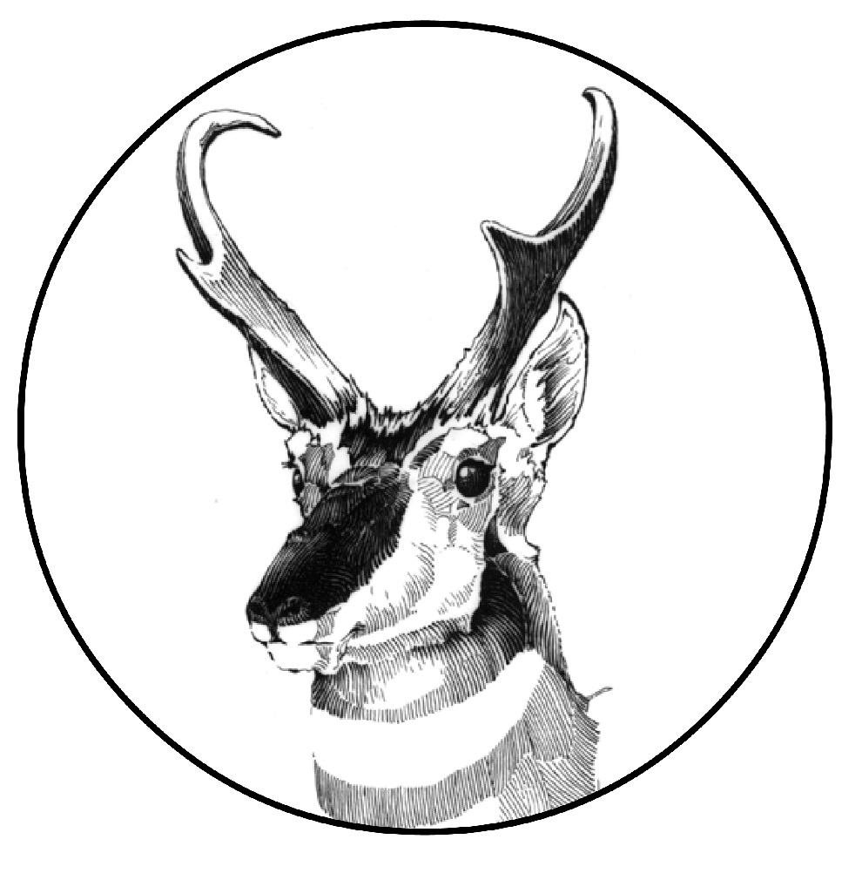
103rd Annual Meeting of the American Society of Mammalogists
ASM Awards ceremony

Slide 3
Catalina Tomé, Chair
International Relations Committee
Carol & Jim Patton Awards
Nuria Di Guida - Sociedad Argentina para el Estudio de los Mamíferos
Cristina Bartolucci - Sociedad Argentina para el Estudio de los Mamíferos

Slide 4
Catalina Tomé, Chair
International Relations Committee
Carol & Jim Patton Awards
Nuria Di Guida - Sociedad Argentina para el Estudio de los Mamíferos
Cristina Bartolucci - Sociedad Argentina para el Estudio de los Mamíferos
ASM International Travel Awards:
Sofía Barbero, early career researcher, Argentina
Stephanye Mata González, graduate student, Mexico

Slide 5
African Research Fellowships
Mohamed Hussein Ali - Kenya, MSc - conservation of giraffes
Patrice Delagnon Assou - Togo, PhD - conservation of pangolins
Keneilweone Kejekgabo - Botswana, MPhil - behavioral ecology of elephants
Howard Maimbo - Zambia, PhD - conservation of large herbivores
Getachew Mulualem - Ethiopia, PhD - ecology of small mammals
Elijah Okwuono - Nigeria, PhD - ecology and conservation of bats
Mauricette Marie Rajaobelina - Madagascar, PhD - population genetics of lemurs

Slide 6
Sergio Solari, Chair
Latin American Fellowship Committee
Latin American Student Field Research Awards
Valeria E. Pomponio (Argentina). PhD student, Universidad Nacional del Comahue
Pedro Ivo Monico (Brazil). PhD student, State University of New Jersey, Newark
Darwin M. Morales-Martínez (Colombia). PhD student, Louisiana State University
Cecilia Contarde (Argentina). PhD student, Universidad Nacional de Córdoba
Nicolás Gorostiaga (Argentina). PhD student, Universidad de Buenos Aires
Diego García-Núñez (Mexico). PhD student, Universidad de Guadalajara

Slide 7
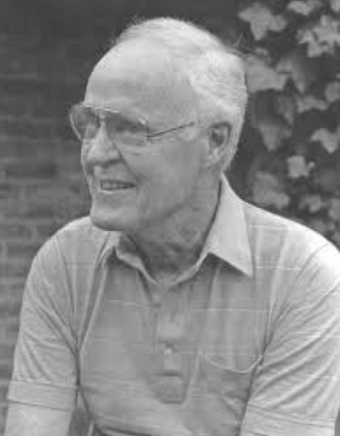
Oliver P. Pearson Award
Sergio Solari, Chair
Latin American Fellowship Committee
Notes:
Nicté Ordóñez, Chair
Latin American Fellowship Committee

Slide 8
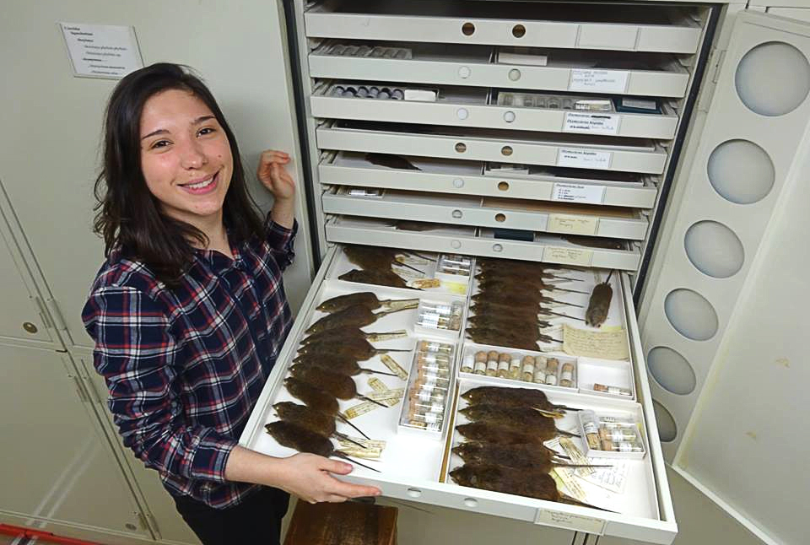
Oliver P. Pearson Award
Dr. Rafaela Missagia (Brazil)
Assistant Professor, Department of Zoology of University of São Paulo
Notes:
Nicté Ordóñez, Chair
Latin American Fellowship Committee

Slide 9
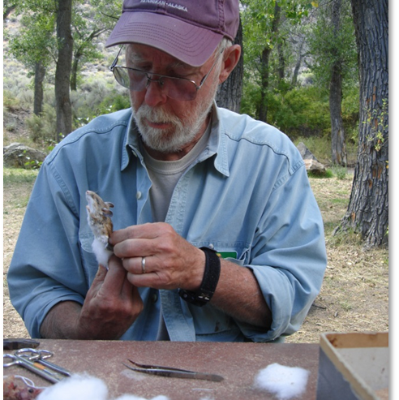
James L. Patton Award
Rebecca Rowe, Chair

Slide 10
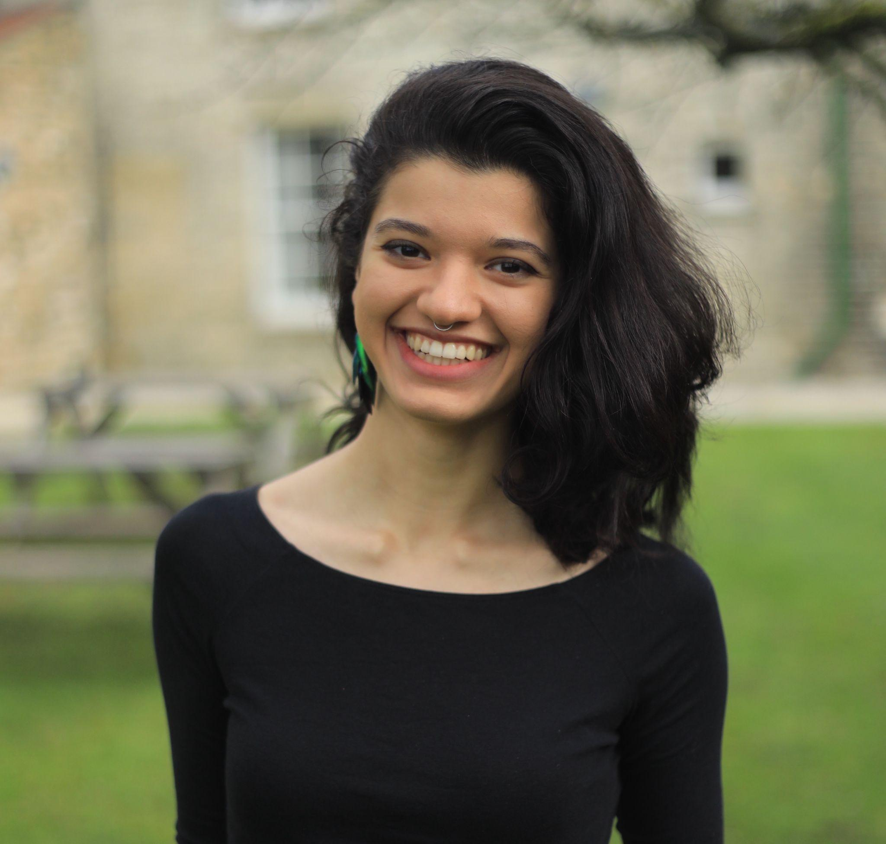
James L. Patton Award
Maya Juman
PhD student, University of Cambridge

Slide 11
Student Science Policy Award
Mariah Schlis-Elias, Chair

Slide 12
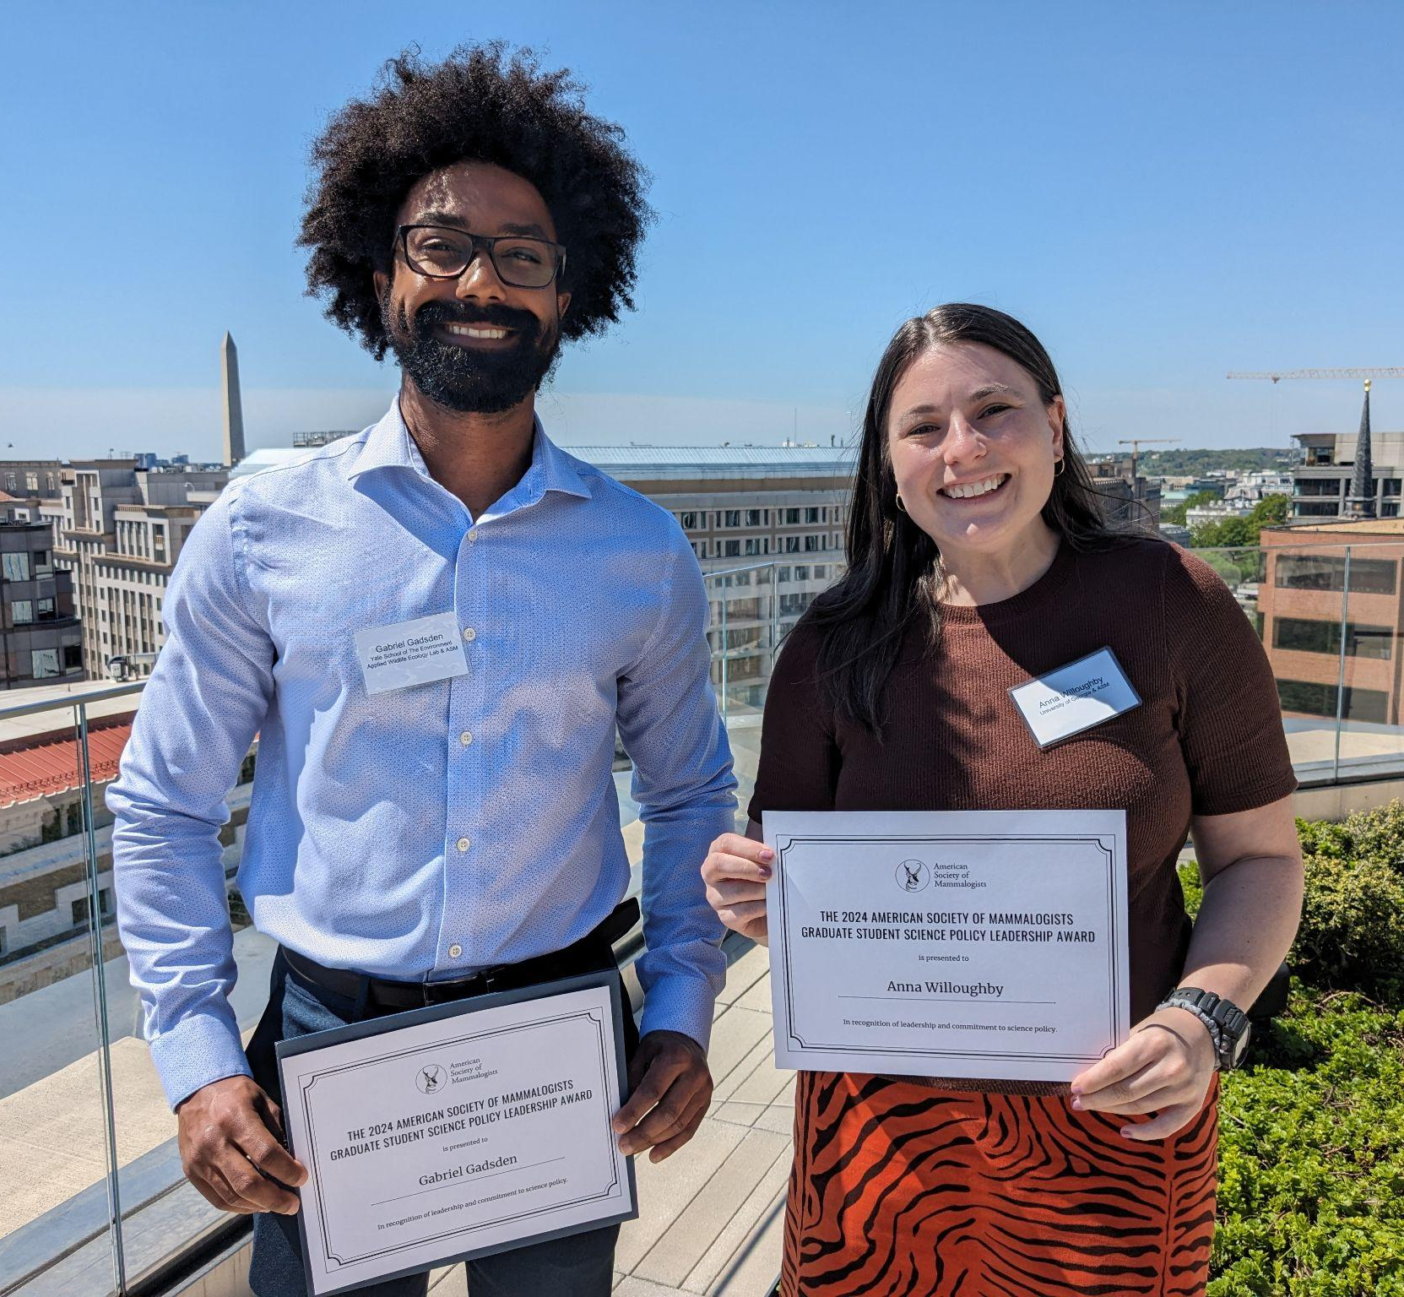
Student Science Policy Award
2024 recipients:
Gabriel Gadsden (Yale)
Anna Willoughby (UGA)

Slide 13
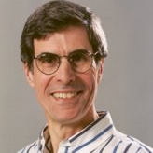
Guy N. Cameron Award
Rob Swihart, Chair

Slide 14
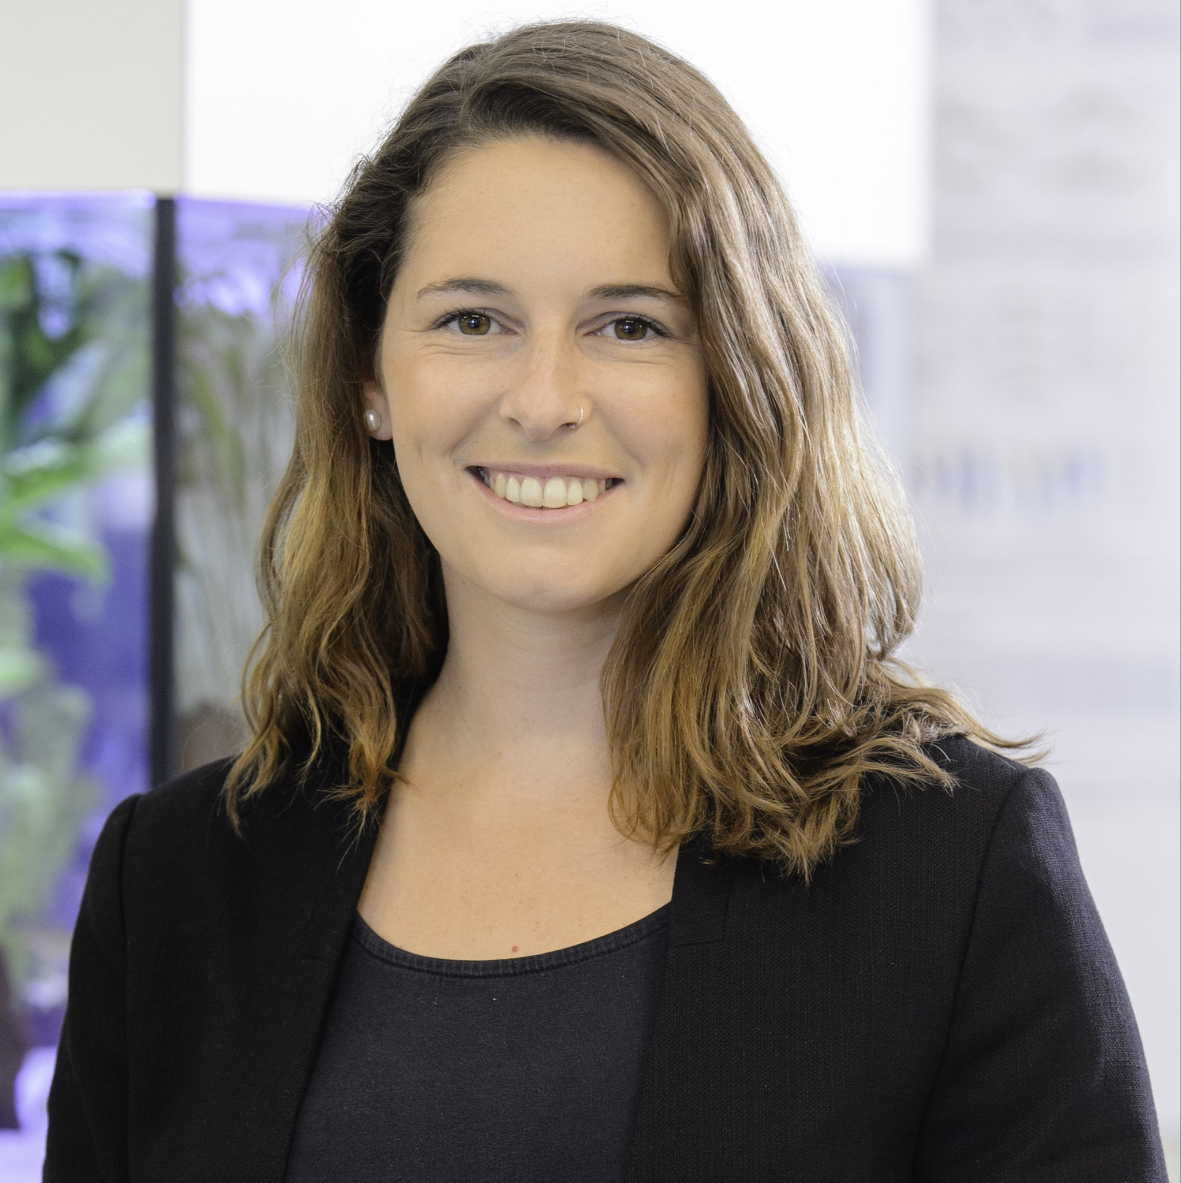
Guy N. Cameron Award
Dr. Sonja Wild

Slide 15
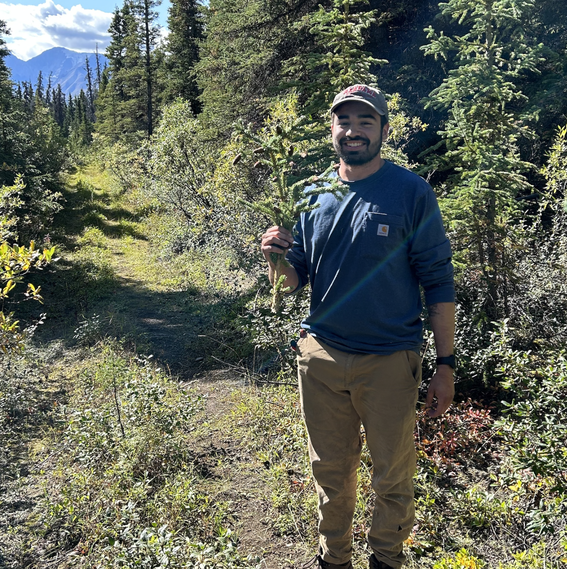
Guy N. Cameron Award
John Paul Williams-Soriano

Slide 16
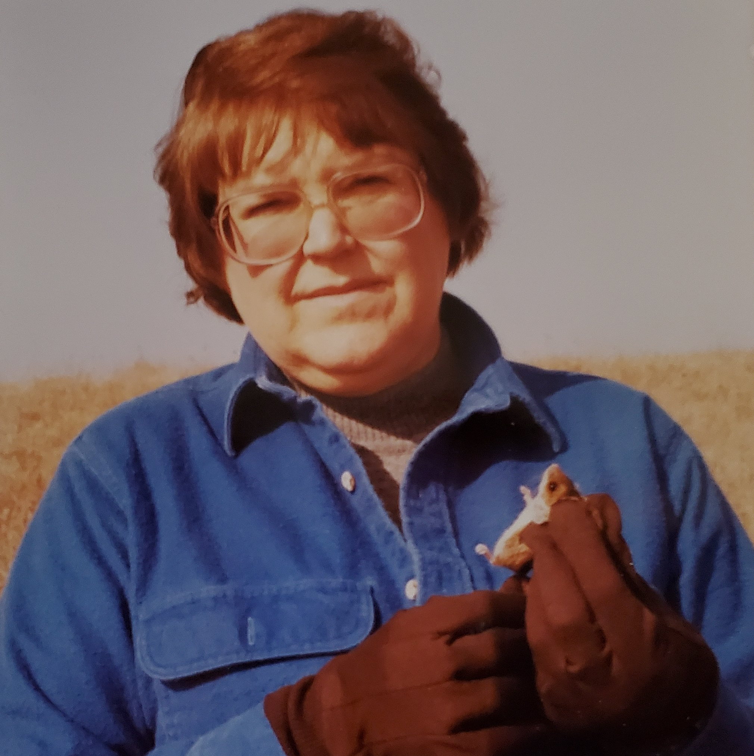
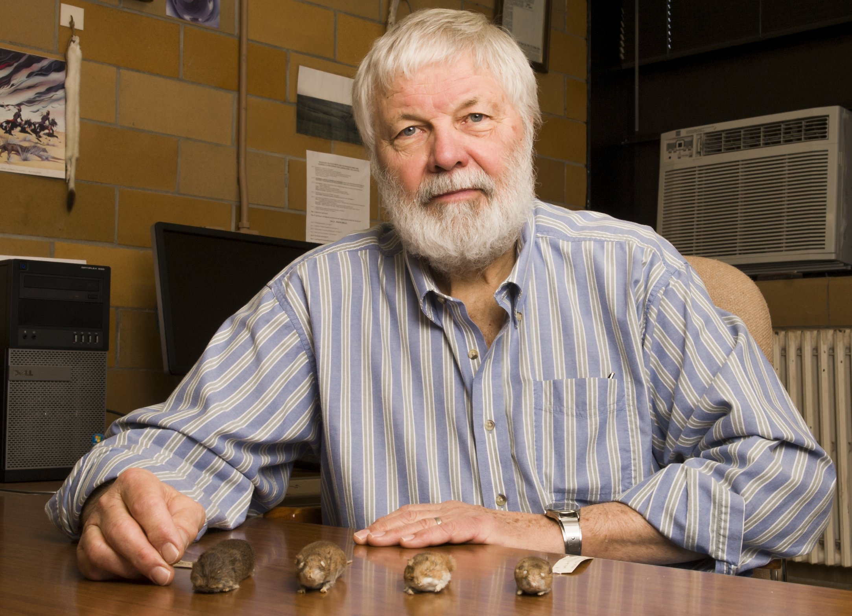
Donald W. and Glennis A. Kaufman Award
Aaron Reed, Chair

Slide 17
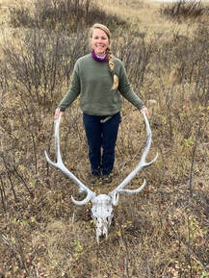
Donald W. and Glennis A. Kaufman Award
Jessie Bainbridge
University of Regina

Slide 18
Black & Indigenous Scholarship Awards
Rhiannon Jakopak, Chair

Slide 19
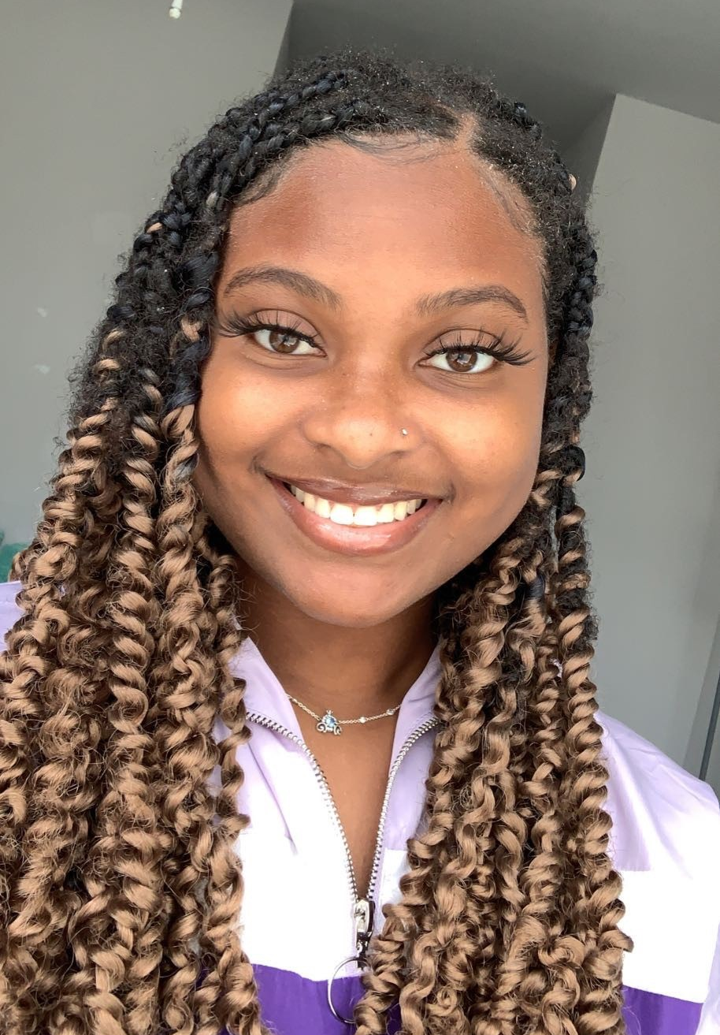
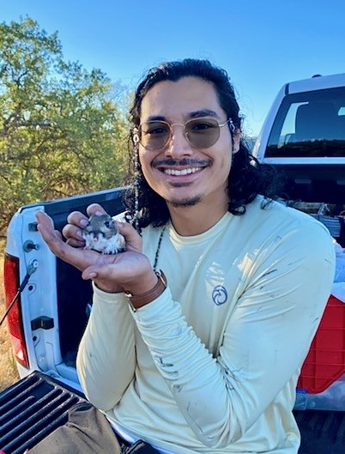
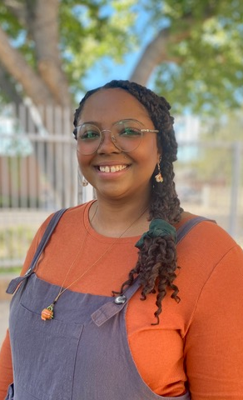
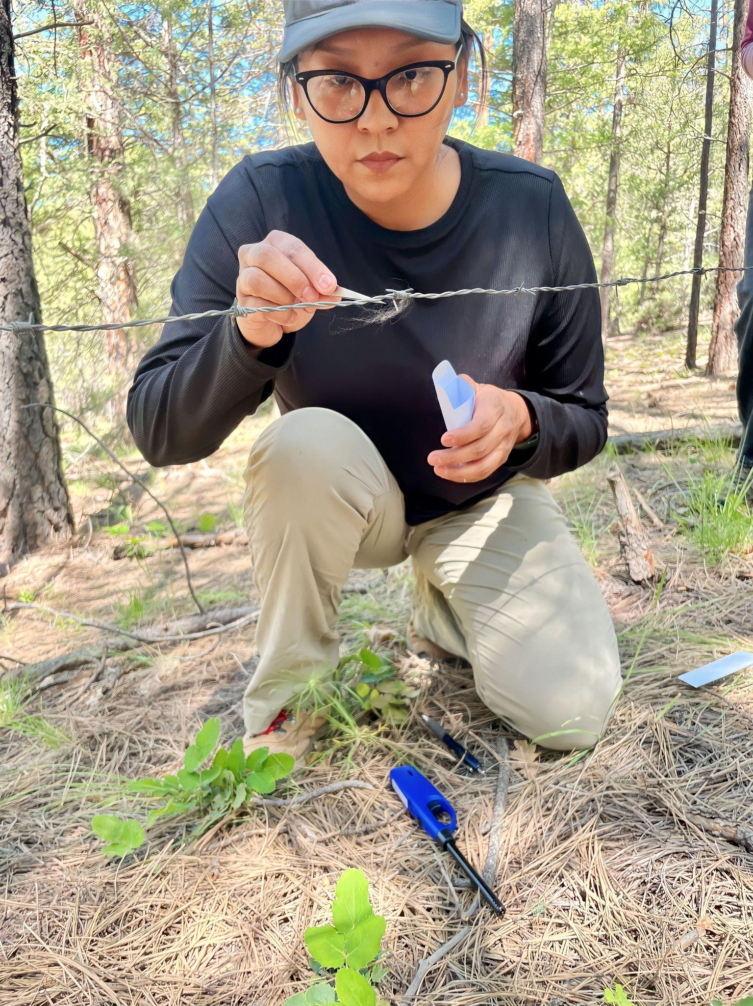
Black & Indigenous Scholarship Awards
Spring 2023
Fall 2023
Ilana Mosely
Tommy Herrera
Tabitha McFarland
Deandra Jones

Slide 20
Rising undergraduates in mammalogy travel support
Ivan Beck, Central Washington University
Nicole Bonello, California State University, Monterey Bay
Ashley Castro, Weber State University
Sophia Koutsogiannis, Arizona State University
Alana Owings, California State University, Monterey Bay
Ryan Grutsch, Kansas State University
Roche Espadron, University of Wyoming
Notes:
IDEA committee

Slide 21
President’s special award for service to the ASM

Slide 22
Fi Choate

Slide 23
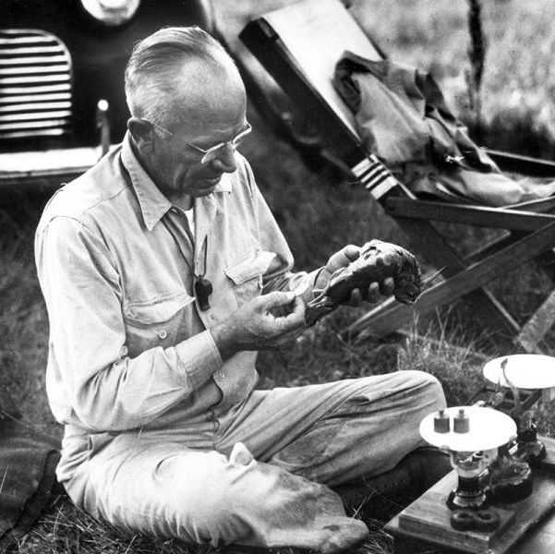
Aldo Leopold Award
Kate Lyons, Chair

Slide 24
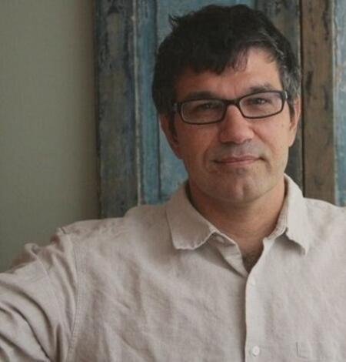
Aldo Leopold Award
Dr. Matthew Kauffman

Slide 25
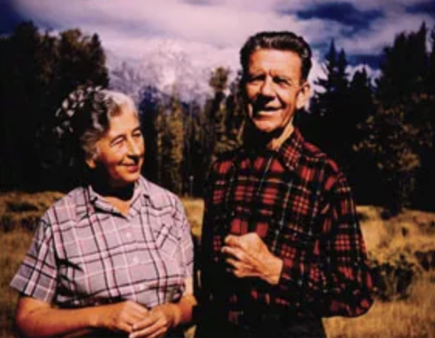
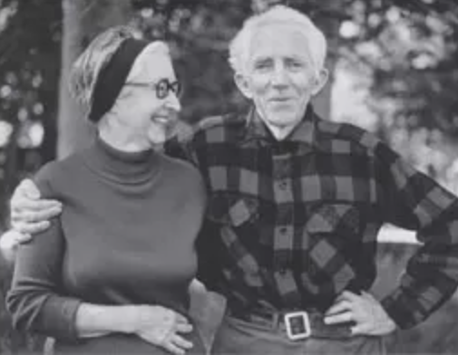
Murie Family Conservation Award
Mardy and Olaus Murie
Louise and Adolph Murie

Slide 26
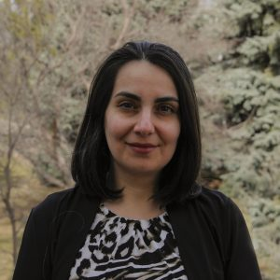
Murie Family Conservation Award
Saeideh Esmaeili

Slide 27
Grants-in-aid Elizabeth Horner Award Albert R. & Alma Shadle Fellowship ASM Fellowship
Angela D. Hornsby, Chair
Grants-in-Aid Committee

Slide 28
Grants-in-Aid of Research
Katie Adler, University of California, Los Angeles
Katie Anderson, Washington State University
Angelica Bahena, Chicago State University
Madeleine Becker, Smithsonian
Brandon Bernhardt, Kansas State University
Laura Blumensaadt, University of Montana
Emily Bogner, University of California Berkeley
Marina Casiano Ruiz, University of New Mexico
Pricilla Ceja, Cal Poly Humboldt
Joshua Cortez, University of New Mexico
Caroline Cummings, the University of Oklahoma
Alexandra DeLuca, University of North Carolina Wilmington
Sylvia Durkin, University of California, Berkeley
Holly Gamblin, University of Manitoba
Sarah Gheida, South Dakota State University
Yadav Ghimirey, University of Florida
Emilyn Gilmore, University of Oklahoma
Samantha Hamilton, Kyoto University
Andrew Hensley, University of Cincinnati
Alexander Hey, University of Kansas Biodiversity Institute
Nicole Lopez, University of Montana
Ellen McMullen, University of Nevada, Reno
Margaret Mercer, University of Arizona
Morgan Pierce, Arizona State University
Andre Plantinga-Kapteyn, University of North Carolina Greensboro
Luke Quarles, University at Buffalo
Esteban Restrepo-Cortes, University of New Mexico
Damien Rivera, Arizona State University
Alicia Roistacher, University of Oklahoma
Sydney Self, University of Texas at San Antonio
Basanta Sharma, Kansas State University
Stavi Tennenbaum, Princeton University
Sjoerd Vos, University of Manitoba
Claire Watersmith, University of North Carolina Wilmington
Amanda Weller, University of North Carolina at Greensboro

Slide 29
Horner Award
Abigail McClain,
George Washington University
The impact of social loss on the behavior and physiology of wild chimpanzees (P. t. schweinfurthii)

Slide 30
Albert R. and Alma Shadle Fellowship

Slide 31
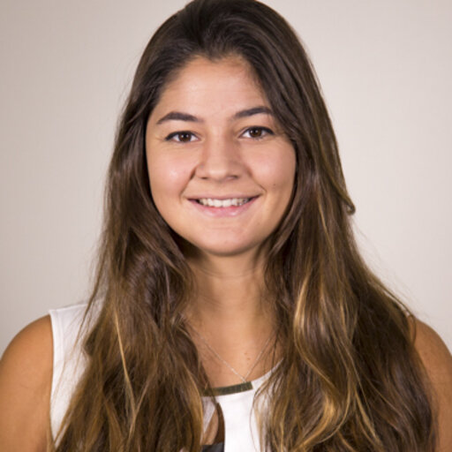
Albert R. and Alma Shadle Fellowship
Nicole Lopez
University of Montana

Slide 32
ASM Fellowship

Slide 33
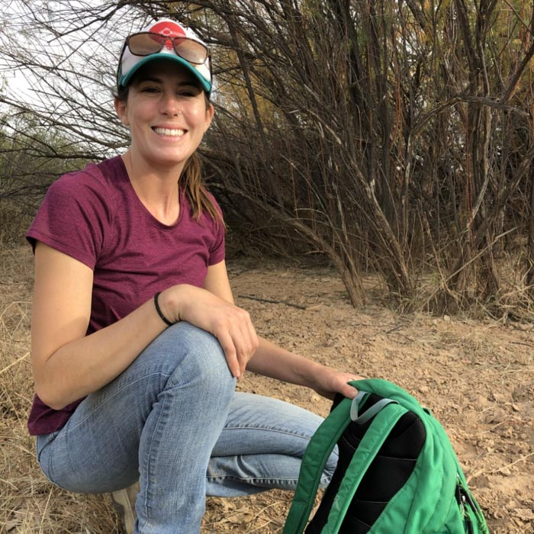
ASM Fellowship
Carson Hedberg
University of New Mexico

Slide 34
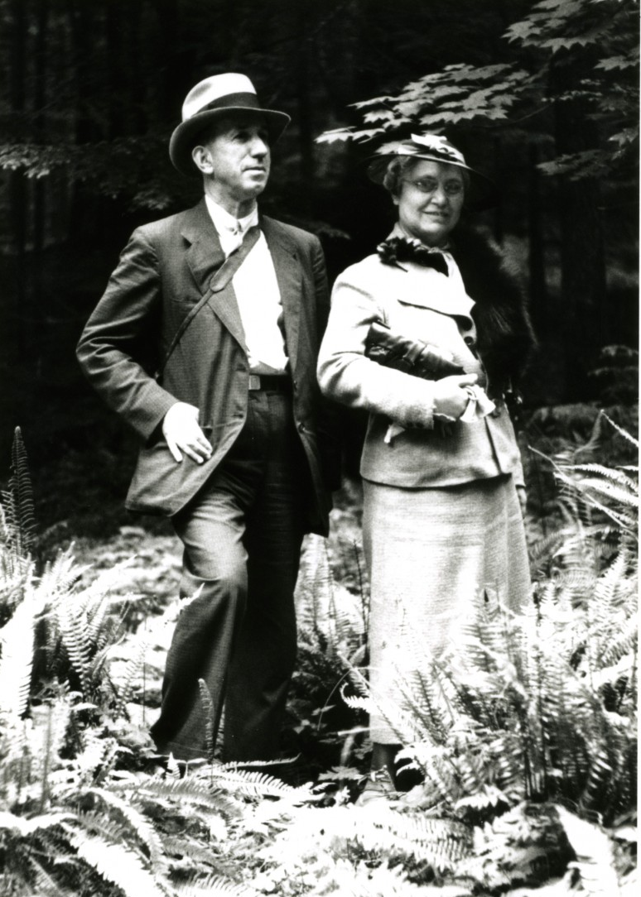
Hartley T. Jackson Award
Ed Heske, Chair
Hartley Jackson and Vernon Bailey, 1935
Hartley and Anna Jackson 1937

Slide 35
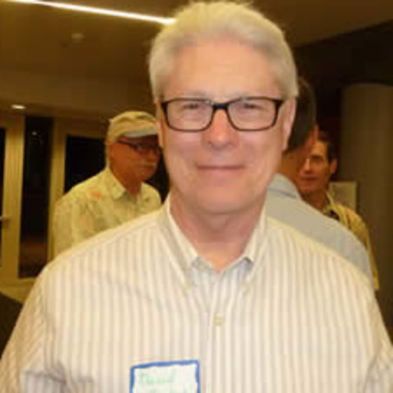
Hartley T. Jackson Award
Dr. David Huckaby
Hartley Jackson and Vernon Bailey, 1935

Slide 36
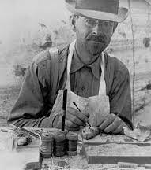
Joseph Grinnell Award
Janet Rachlow, Chair

Slide 37
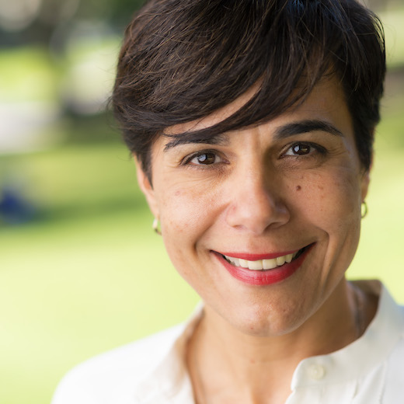
Joseph Grinnell Award
Dr. Matina Kalcounis-Rueppell

Slide 38
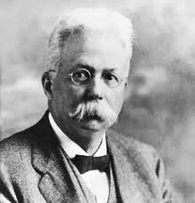
C.H. Merriam Award
Sharon Jansa, Chair

Slide 39
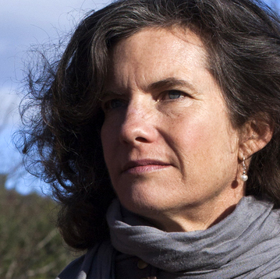
C.H. Merriam Award
Dr. Felicia Keesing

Slide 40
Thank you again!
Diamond Sponsor: Oxford University Press
Silver Sponsor: H. B. Sherman Traps, Inc.
Bronze Sponsors: Johns Hopkins University Press, WEST, Inc., and Wildlife Acoustics
Vendors: Colorado State University, Mountain Lion Foundation
Local Host Committee Sponsors: CU Boulder Department of Ecology & Evolutionary Biology, CU Museum of Natural History

Slide 41
A HUGE THANKS TO
John Hanson and the Program Committee
Kerrell Dunsmore, the next great event
Christy Classi, ASM Business Manager
and especially …
Christy McCain and her folks from the CU Boulder Department of Ecology & Evolutionary Biology and CU Museum of Natural History

